Slide 1
EAT AND ROLL - AN ONLINE FOOD ORDERING SYSTEM PRATHEESH – 022 SOORYA HARSHA -035
PROJECT GUIDE
TEAM MEMBERS
DR. J B JONA ,
ASSOCIATE PROFESSOR
DEPARTMENT OF MCA,
CIT
Notes:
Hai

Slide 2
Agenda
Abstract
Aim, Objective & Scope
System (Hardware / Software) Requirements
Functional & Non-functional requirements
Use Case Model
Activity Diagram
Module Design
Architecture Diagram
Table Design
Conclusion

Slide 3
ABSTRACT
An Online Food Ordering System is proposed here which simplifies the food ordering process. The proposed system shows an user interface and update the menu with all available options so that it eases the customer work. Customer can choose multiple foods from multiple restaurants to make an order and can choose the payment method that they prefer .
The order confirmation is sent to the customer. The order is placed in the queue and updated in the database and returned in real time. This system assists the staff to go through the orders in real time and process it efficiently with minimal errors.
The system consists of three main components a customer-facing website, a restaurant-facing dashboard, and a back-end database. The customer-facing website allows customers to browse the menus of participating restaurants, select items, and place orders

Slide 4
ABSTRACT
The restaurant-facing dashboard allows restaurant staff to view and process orders. The back-end database stores all of the data related to the system, including customer profiles, restaurant menus, and order history.
The online food ordering system will provide a number of benefits for both customers and restaurants. For customers, the system will make it easier and more convenient to order food online. For restaurants, the system will provide a way to manage orders more efficiently and track inventory more effectively.

Slide 5
AIM , OBJECTIVE & SCOPE
Aim:
To provide a convenient and efficient way for customers to order food from restaurants.
To improve customer satisfaction with the food ordering process.
To increase sales for restaurants.
Objectives:
To develop a system that is easy to use for both customers and restaurants.
To develop a system that is secure and reliable.
To develop a system that is scalable to accommodate a growing number of users and restaurants.

Slide 6
AIM , OBJECTIVE & SCOPE
Scope:
The system will allow customers to view a restaurant's menu, add items to their cart, and place an order.
The system will allow restaurants to manage their menus, track orders, and process payments.
The system will provide administrators rights to approve a restaurant to use the Eat and Roll marketplace to publish their menu and also Decline the restaurants based on their performance.

Slide 7
SYSTEM REQUIREMENTS
HARDWARE REQUIREMENTS
Technical descriptions of the computer components and capabilities are described by hardware specification. The hardware specification for the online food ordering web application is given below.
Processor: Intel i3
Processor speed: 2.5 GHz
RAM: 4 GB (Min)
Hard Disk: 128 GB

Slide 8
SYSTEM REQUIREMENTS
SOFTWARE REQUIREMENTS
The software descriptions of the project and its functionality are explained in the software specification. Software requirements are given below,
Operating system: Windows OS
Front-end: HTML, CSS, python ,Ajax ,JQuery , JavaScript, Bootstrap
Framework: Django
Database: postgreSql

Slide 9
REQUIREMENT ANALYSIS
NON-FUNCTIONAL REQUIREMENTS :
Performance: The system should provide quick responses to user actions, ensuring minimal delay in processing orders, payments, and other operations. The system should handle a large number of concurrent users and transactions without performance degradation.
Reliability: The system should be highly available, minimizing downtime and ensuring continuous operation. The system should be able to recover gracefully from failures, ensuring that critical functions remain operational. Regular data backups should be performed to protect against data loss, and there should be a robust recovery mechanism in place.
Security: Authentication and authorization: The system should have secure mechanisms for user authentication and authorization to ensure that only

Slide 10
REQUIREMENT ANALYSIS
authorized personnel can access sensitive information or perform critical actions. Sensitive user data, such as personal information and payment details, should be encrypted and stored securely to prevent unauthorized access.
Scalability: The system should be able to handle increasing workload by adding more resources to individual components. The system should support adding more vendor partners and handling a growing number of users without significant performance degradation.
Usability: The system should have an intuitive and user-friendly interface that allows vendors to easily manage their menus, track orders, and perform other relevant tasks. The system should provide clear documentation and training resources to help vendors understand and effectively use the system's features.

Slide 11
REQUIREMENT ANALYSIS
FUNCTIONAL REQUIREMENTS :
User Registration and Authentication: Users should be able to create accounts by providing their personal information, email account, and optional contact details. The system should verify user credentials during login to ensure secure access to their accounts.
Vendor Management: Vendors should be able to register their profiles and provide necessary information such as contact details, menu items, and pricing. The system should facilitate the onboarding process for new vendors, including verification of their credentials. Vendors should be able to create, update, and manage their menus, including adding new dishes, setting prices, and specifying availability
Email Verification: The user account will be activated only after the user has verified his account through the link sent to his/her email account. The vendor account verification status will also be updated through the email account.

Slide 12
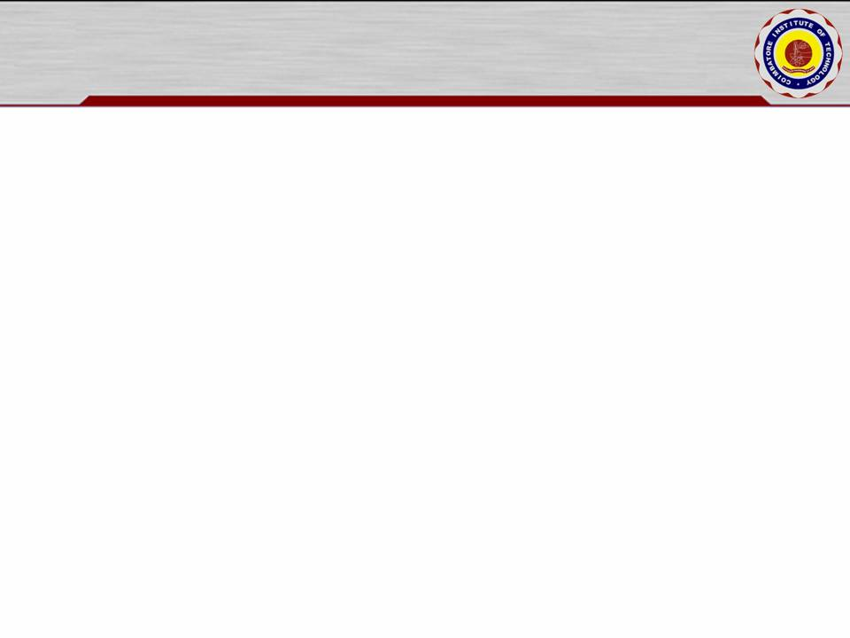
REQUIREMENT ANALYSIS
FUNCTIONAL REQUIREMENTS :
Advanced Search: The customers will be able to search for the vendors available in a particular range of area through the filter option implemented with the help of geocoding and places API. The exact latitude and longitude details can the fetched with the help of these API’s. Similarly with the help of googles auto complete and places API’s the expected places will be auto suggested in the search box.
Edit profile: Both the customers and vendors will be able to edit their profiles including changing names, address, profile photo and location details etc.
Order Placement and Summary: Users should be able to add items from multiple vendors to their shopping cart, specify quantities, and customize orders. Users should have a clear summary of their order, including items, quantities, and total cost, before proceeding to checkout.

Slide 13
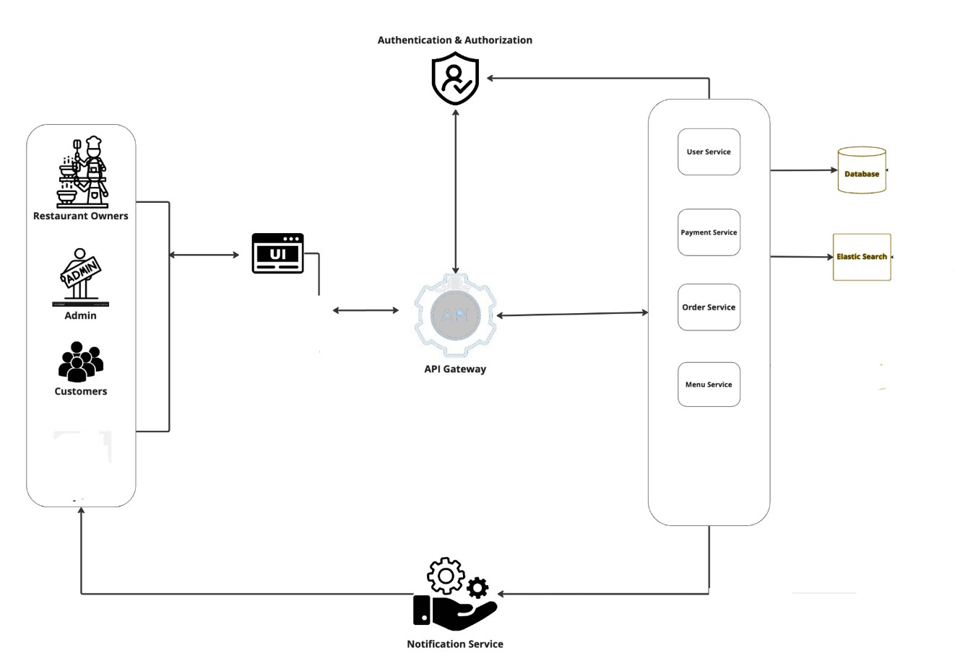
ARCHITECTURAL DESIGN

Slide 14
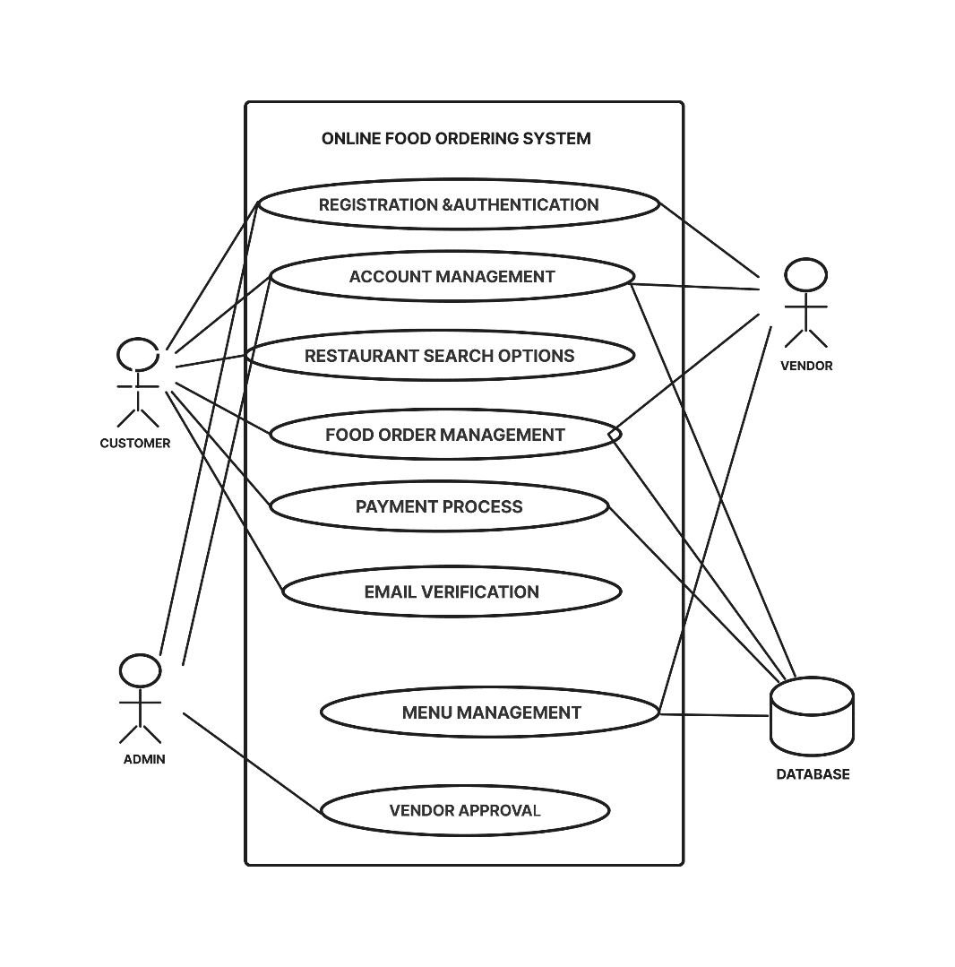
USE CASE

Slide 15
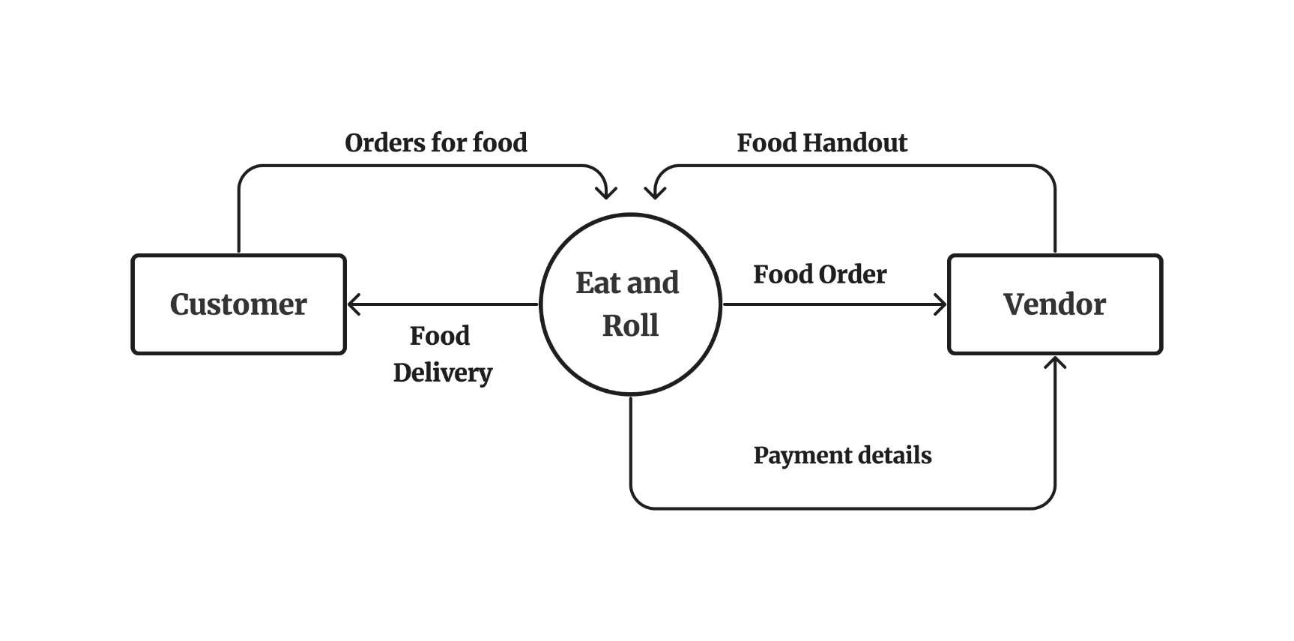
LEVEL – 0 DFD

Slide 16
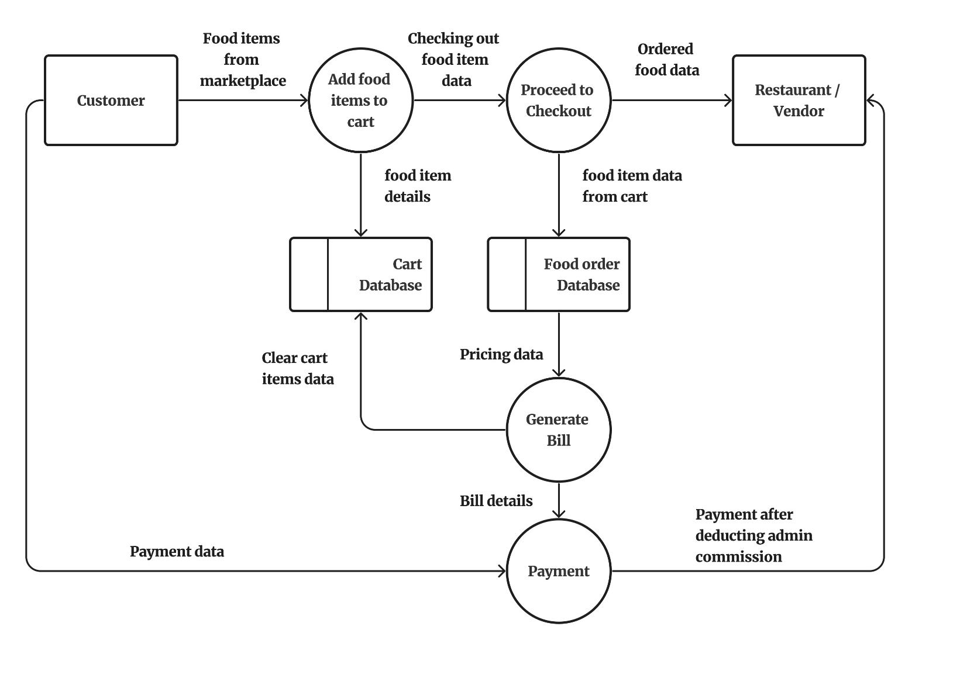
LEVEL – 1 DFD FOOD ORDER

Slide 17
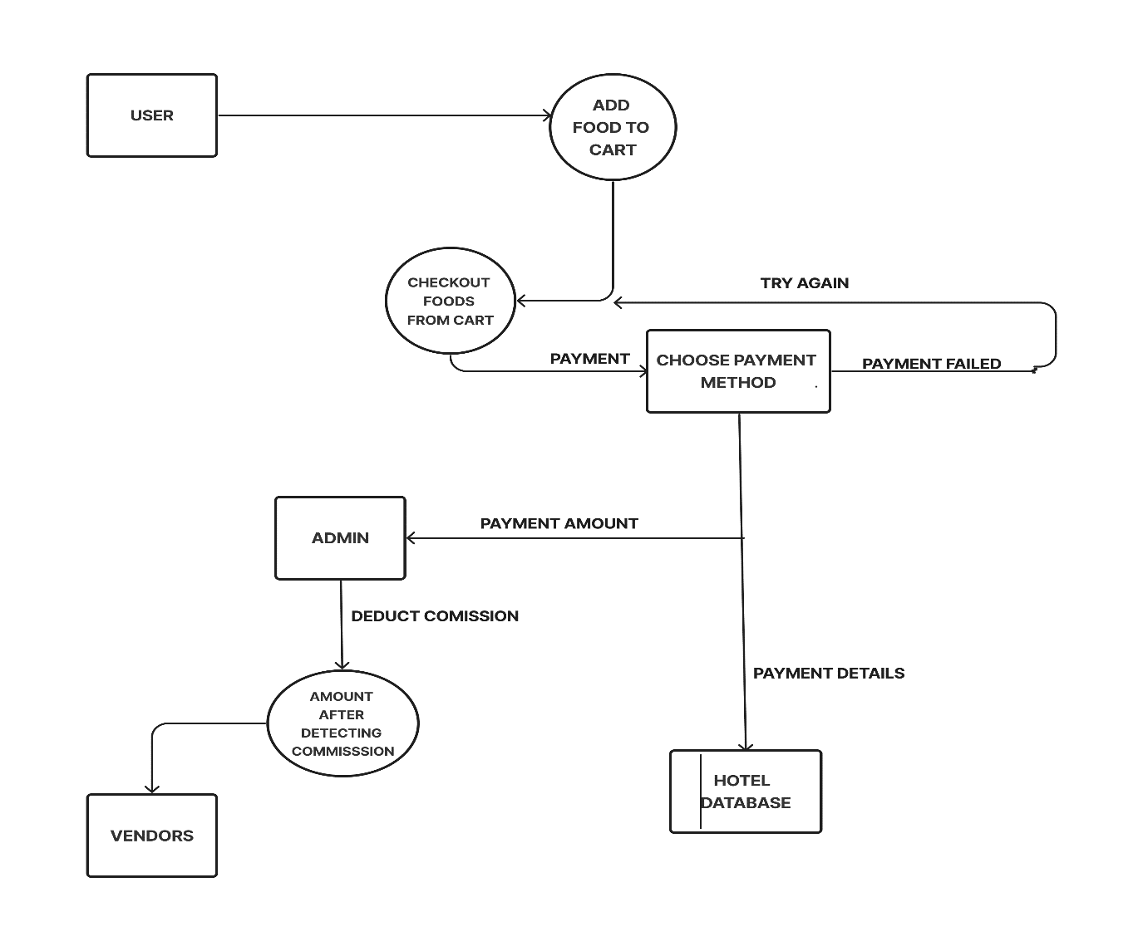
LEVEL 2 DFD FOR PAYMENT

Slide 18
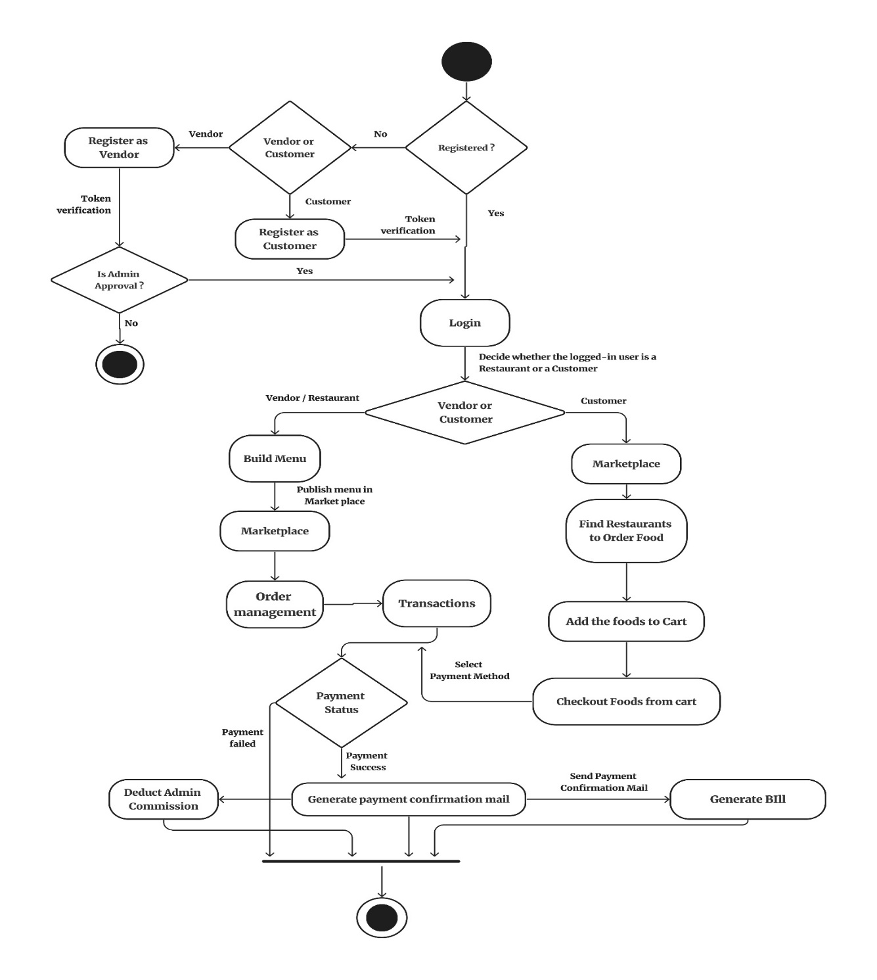
ACTIVITY DIAGRAM

Slide 19
CONCLUSION
The objectives of the online food delivery project have been met. The system has been able to manage the details of food items, categories, customers, orders, and confirmed orders. The system has also been able to improve the efficiency and profitability of restaurants.

Slide 20
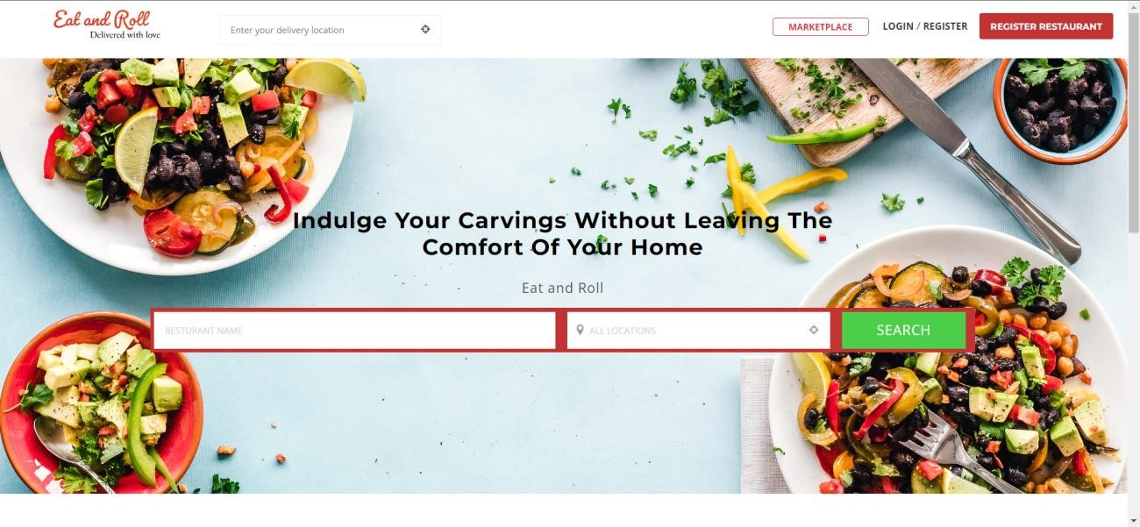
SCREENSHOTS
HOME PAGE

Slide 21
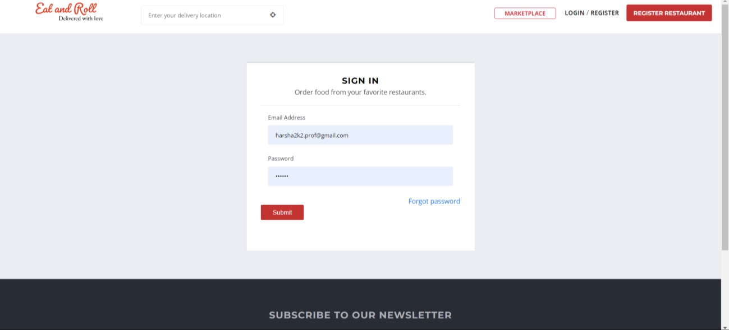
SCREENSHOTS
LOGIN PAGE

Slide 22
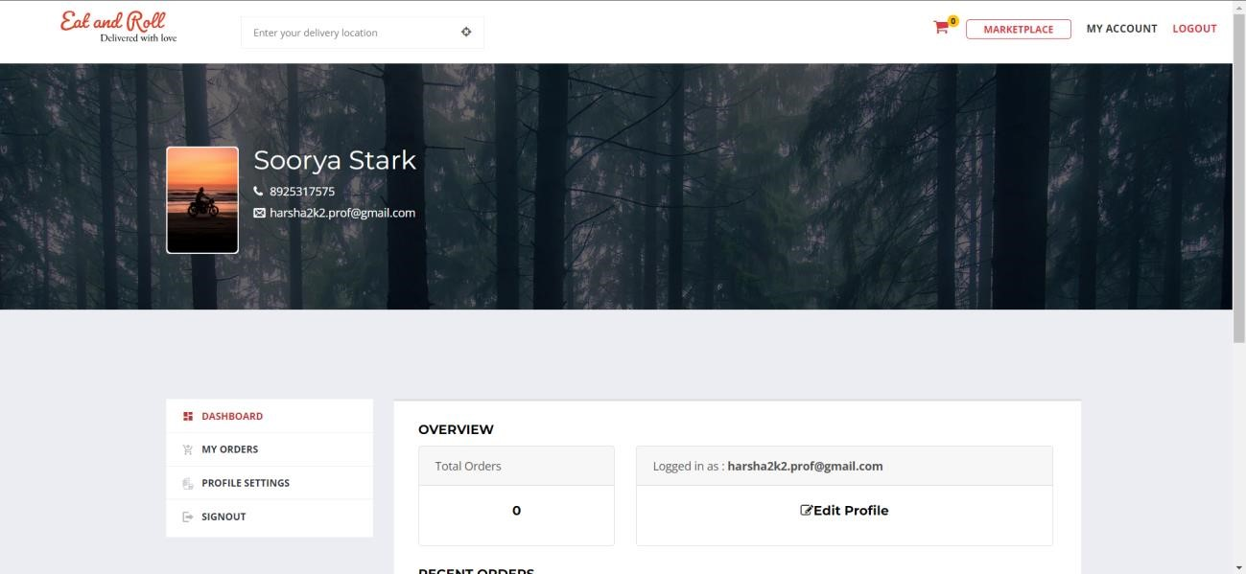
SCREENSHOTS
CUSTOMER DASHBOARD

Slide 23
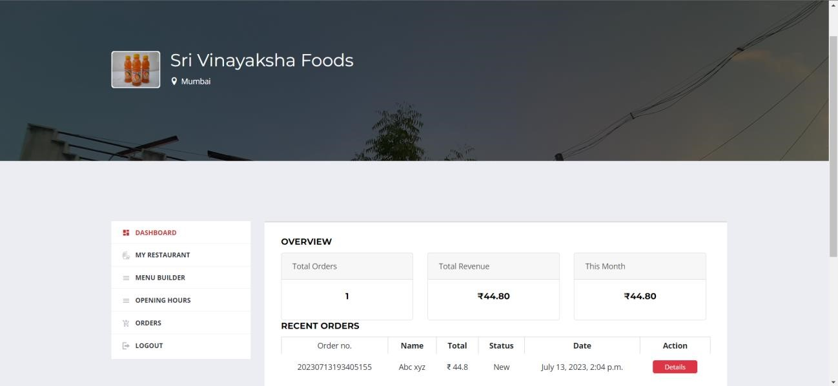
SCREENSHOTS
VENDOR DASHBOARD

Slide 24
TABLES
USER TABLE
Field Name | Data Type | Description | Constrains
User_id | Bigint | User ID | Primary key
First_name | Character varying (50) | First name of User | Not Null
Last_name | Character varying (50) | Last name of User | Not Null
Email | Character varying (100) | Email Id of the User | Unique = True
Username | Character varying (100) | Username for the account | Unique = True
Password | Character varying (128) | Password of the user | Not Null
Phone_number | Bigint | Phone number of the user | Not Null
Role | Smallint | 1 represents Vendor account and 2 represents Customer account | Not Null
Is_admin | Bool | Tells whether the user is admin or not | Default = False
Is_active | Bool` | Tells whether the account is activated or not | Default = False
Created_date | Timestamp with timezone | Date and time of the account creation | Not Null
Modified_date | Timestamp with timezone | Date and time of the account modified | Not Null
Last_login | Timestamp with timezone | Date and time of the last login | Not Null

Slide 25
TABLES
USER PROFILE
Field Name | Data Type | Description | Constrain
User_profile_id | Bigint | User profile ID | Primary key
User_id | Bigint | User ID | Foreign key
Profile_picture | Character varying (30) | URL of the user cover photo | Only jpg,jpeg and png
Cover_photo | Character varying (30) | URL of the user cover photo | Only jpg,jpeg and png
address | Character varying (100) | Address of the User | Not Null
Country | Character varying (30) | Country of the user | Not Null
State | Character varying (30) | State of the user | Not Null
City | Character varying (30) | City of the user | Not Null
Pin_code | int | Pin_code of the user address | Not Null
Created_at | Timestamp with time zone | Date and time of the account creation | Not Null
Modified_at | Timestamp with time zone | Date and time of the account modified | Not Null

Slide 26
TABLES
VENDOR TABLE
Field Name | Data Type | Description | Constrain
Vendor_id | Bigint | Vendor ID | Primary Key
User_id | Bigint | User ID | Foreign key
User_profile_id | Bigint | User profile ID | Foreign key
Vendor_name | Character varying (50) | Name of the vendor | Not Null
Created_at | Timestamp with time zone | Date and time of the account creation | Not Null
Modified_at | Timestamp with time zone | Date and time of the account modified | Not Null

Slide 27
TABLES
PAYMENT TABLE
Field Name | Data Type | Description | Constrain
Payment_id | Bigint | ID of the Payment | Primary Key
User_id | Bigint | ID of the user | Foreign Key
Transaction_id | Character varying(100) | ID of the transaction | Not Null
Payment_method | Character varying(100) | Method of Payment (Paypal / razorpay) | Not Null
Amount | Int | Amount of the ordered food | Not Null
Status | Character varying(100) | Success or Failure status of the payment | Not Null
Created_at | Timestamp with the time zone | Date and time of the payment | Not Null

Slide 28
TABLES
ORDER TABLE
Field Name | Data Type | Description | Constrain
Order_id | Bigint | ID of the Order | Primary Key
Payment_id | Bigint | ID of the Payment | Foreign Key
User_id | Bigint | ID of the User | Foreign Key
Order_number | Character varying(20) | Order number | Unique = True
First_name | Character varying (50) | First name of User | Not Null
Last_name | Character varying (50) | Last name of User | Not Null
Email | Character varying (100) | Email Id of the User | Unique = True
Address | Character varying (30) | Address of the Customer | Not Null
Country | Character varying (30) | Country of the Customer | Not Null
State | Character varying (30) | State of the Customer | Not Null
Pin_code | Int | Pin_code of the Customer address | Not Null
Tax_data | Jasonb | GST and CSGT of the ordered food | Not Null
Total_tax | Int | Sum of both GST and CGST | Not Null
Payment_method | Character varying(20) | Method of payment (Paypal / Razorpay) | Not Null
Is_ordered | Bool | Wheather the food is Ordered or not | Not Null
Created_at | Timestamp with time zone | Date and time of the Account created | Not Null
Updated_at | Timestamp with time zone | Date and time of the food item details last modified | Not Null

Slide 29
CONCLUSION
Online food ordering systems have become increasingly popular in recent years. They offer a convenient and efficient way for customers to order food from their favourite restaurants. The systems also provide a number of benefits for restaurants, such as increased sales and improved customer satisfaction.
The online food ordering system project is a valuable tool for both customers and restaurants. It is a convenient, efficient, and effective way to order food.
As more and more people become comfortable with online ordering, the demand for this type of service will continue to grow. The project has the potential to revolutionize the way people order food, and it is sure to continue to grow in popularity in the years to come.

